Slide 1
Bipolar Junction Transistors

Slide 2
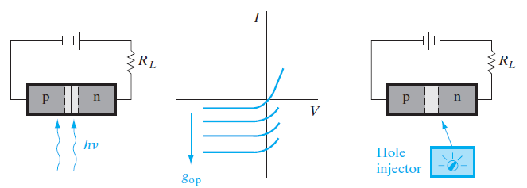
Fig. 1: External control of the current in a reverse-biased p-n junction: (a) optical generation; (b) junction I–V characteristics as a function of EHP
generation; (c) minority carrier injection by a hypothetical device.

Slide 3
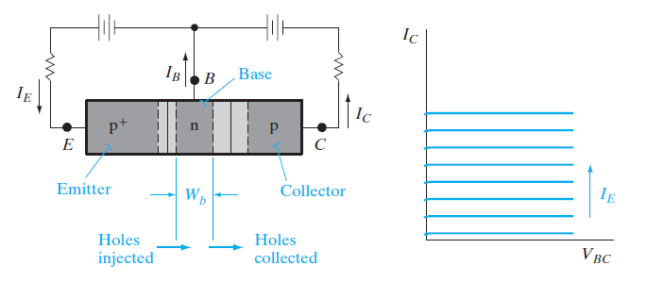
A convenient hole injection device is a forward-biased p+-n junction.
The current in such a junction is due to primarily holes injected from the p+ region into the n material.
If we make the n side of the forward-biased junction the same as the n side of the reverse-biased junction, the p+-n-p structure of Fig 2.
Fig.2: A p-n-p transistor: (a) schematic representation of a p-n-p device (b) I–V characteristics of the reverse-biased n-p junction as a function of emitter current.

Slide 4
With this configuration, injection of holes from the p+-n junction into the center n region supplies the minority carrier holes to participate in the reverse current through the n-p junction.
The injected holes do not recombine in the n region before they can diffuse to the depletion layer of the reverse-biased junction.
Thus we must make the n region narrow compared with a hole diffusion length.
The structure we have described is a p-n-p BJT.
The forward-biased junction that injects holes into the center n region is called the emitter junction, and the reverse-biased junction that collects the injected holes is called the collector junction.
The p+ region, which serves as the source of injected holes, is called the emitter, and the p region into which the holes are swept by the reverse-biased junction is called the collector.

Slide 5
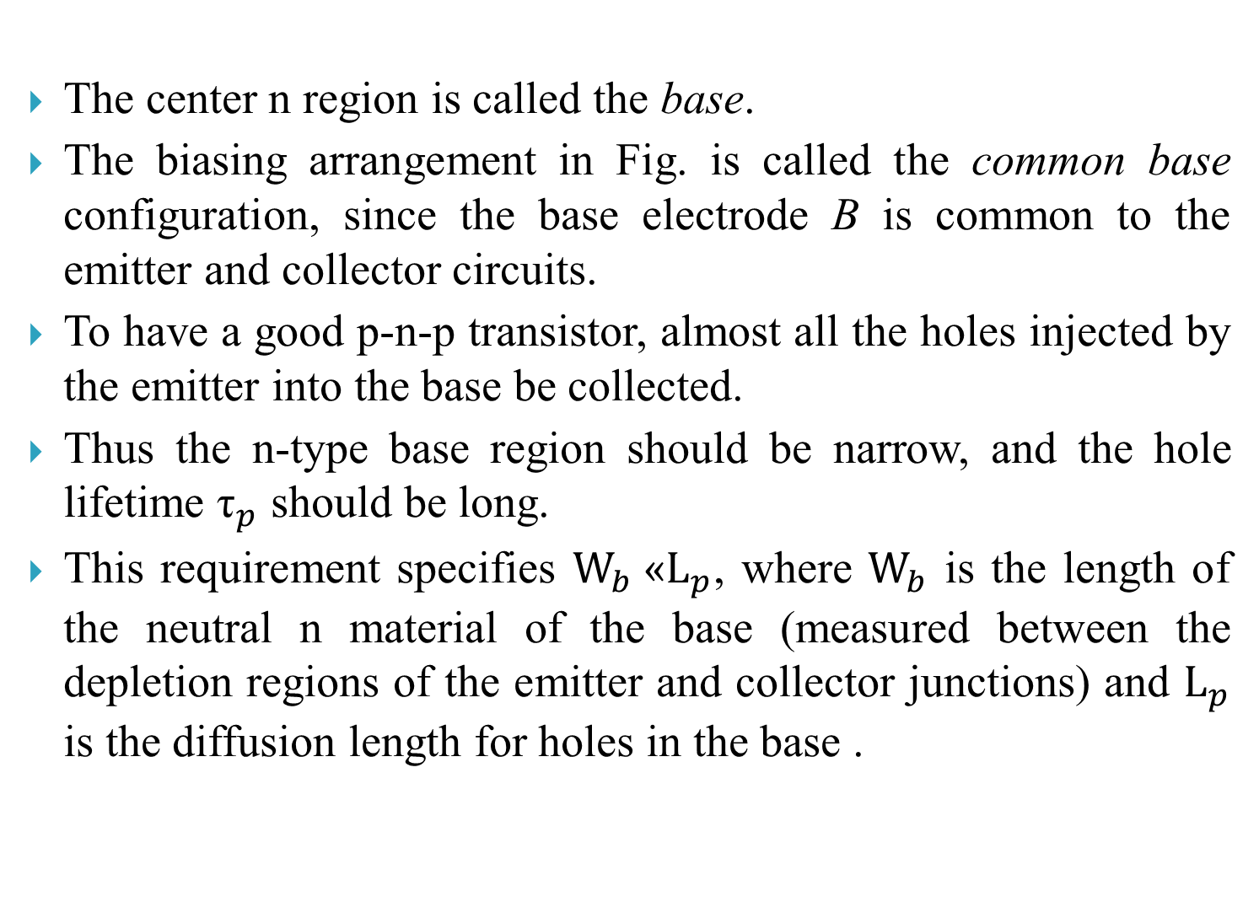
The center n region is called the base.
The biasing arrangement in Fig. is called the common base configuration, since the base electrode B is common to the emitter and collector circuits.
To have a good p-n-p transistor, almost all the holes injected by the emitter into the base be collected.
Thus the n-type base region should be narrow, and the hole lifetime ${\text{τ}}_{p}$ should be long.
This requirement specifies ${\text{W}}_{b}$«${\text{L}}_{p}$, where ${\text{W}}_{b}$ is the length of the neutral n material of the base (measured between the depletion regions of the emitter and collector junctions) and ${\text{L}}_{p}$ is the diffusion length for holes in the base .

Slide 6
A second requirement is that the current IE crossing the emitter junction should be composed entire holes injected into the base, rather than electrons crossing from base to emitter.
This requirement is satisfied by doping the base region lightly compared with the emitter, so that the p+-n emitter junction results.

Slide 7
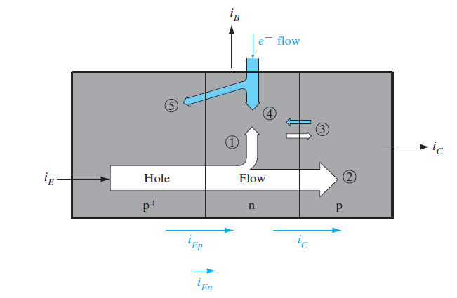
Fig.3: Summary of hole and electron flow in a p-n-p transistor with proper biasing: (1) injected holes lost to recombination in the base; (2) holes reaching the reverse-biased collector junction; (3) thermally generated electrons and holes making up the reverse saturation current of the collector junction; (4) electrons supplied by the base contact for recombination with holes; (5) electrons injected across the forward-biased

Slide 8
Since the direction of hole flow is from the emitter to collector the current IE flows into the emitter of a biased p-n-p transistor and that Ic flows out at the collector.
In a good transistor the base current will be very small and the collected hole current IC is almost equal to IE.
There must be some base current, however, due to requirements of electron flow into the n-type base region (Fig. 3).

Slide 9
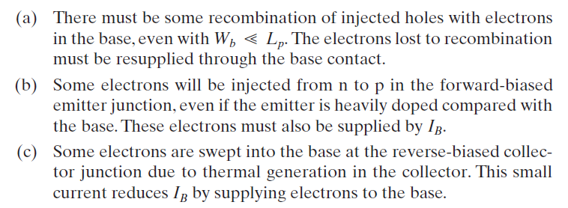
We can report IB physically by three dominant mechanisms:

Slide 10
The sources of the base current are (1) recombination in the base and (2) injection into the emitter region.
Both of these effects can be greatly reduced by device design.
In a well-designed transistor, IB will be a very small fraction (perhaps one-hundredth) of IE.
In an n-p-n transistor the three current directions are reversed, since electrons flow from the emitter to collector and holes must be supplied to the base.
The physical mechanisms for operation of the n-p-n can be understood simply by reversing the roles of electrons and holes in the p-n-p discussion.

Slide 11
BJT Fabrication
The first transistor invented by Bardeen and Brattain in 1947 was the point contact transistor.
This basic invention rapidly led to the BJT, in which charge injection and collection was achieved using two p-n junctions in proximity to each other.
The most commonly used technique for making BJTs is double polysilicon, self-aligned n-p-n Si BJT.
Use of n-p-n transistors is more popular than p-n-p devices because of the higher mobility of electrons compared with holes.

Slide 12
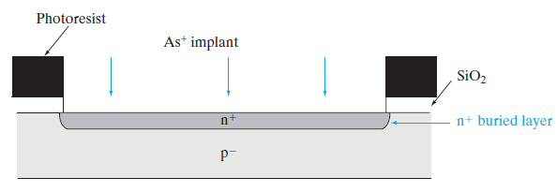
Process flow for double polysilicon, selfaligned n-p-n BJT:
A p-type Si substrate is oxidized, windows are defined using photolithography and etched in the oxide.
Using the photoresist and oxide as an implant mask, a donor with very small diffusivity in Si, such as As or Sb, is implanted into the open window to form a highly conductive n+ layer.
Fig a: n+ buried layer formation;

Slide 13
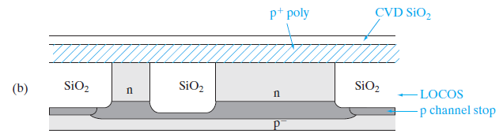
Subsequently, the photoresist and the oxide are removed, and a lightly doped n-type epitaxial layer is grown.
During this high temperature growth, the implanted n+ layer diffuses only slightly toward the surface and becomes a conductive buried collector (also called a sub-collector).
The n+ sub-collector layer guarantees a low collector series resistance when it is connected subsequently to the collector ohmic contact, sometimes through the use of an optional, masked deep n+ “sinker” implant or diffusion only in the collector contact region.
Fig (b): n epitaxy followed by LOCOS isolation

Slide 14
The lightly doped n-type collector region above the n+ sub-collector in the part of the BJT where the base and emitter are formed ensures a high base-collector reverse breakdown voltage.
For integrated circuits involving not just discrete BJTs, but many interconnected transistors, there are issues involving electrical isolation of adjacent BJTs in order to ensure that there is no electrical cross-talk between them.
An isolation can be achieved by LOCOS (Local Oxidation of Silicon) to form field or isolation oxides after a P channel stops implant.
Another isolation scheme that is particularly well suited for high-density bipolar circuits involves the formation of shallow trenches by reactive ion etching (RIE), backfilled with oxide and polysilicon.
In this process a nitride layer is patterned and used as an etch mask for an anisotropic etch of the silicon to form the trench.

Slide 15
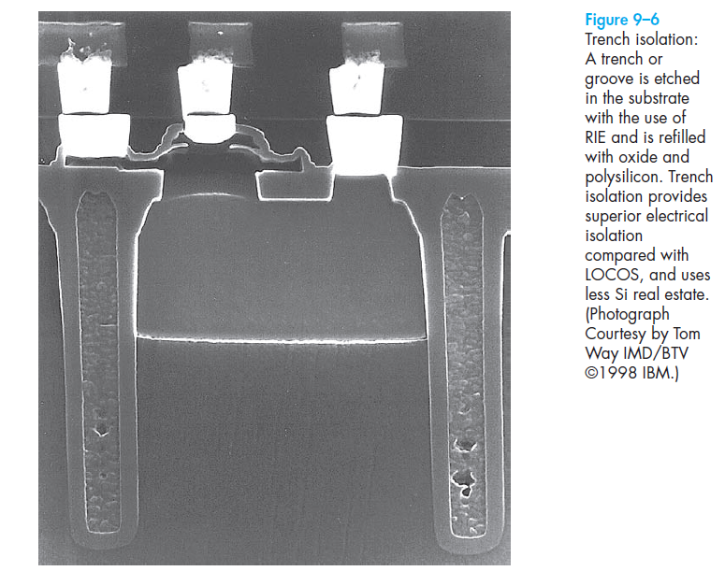

Slide 16
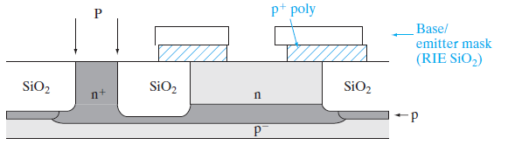
Using RIE, a narrow trench about 1 𝞵m deep can be formed with very straight sidewalls.
Oxidation inside the trench forms an insulating layer, and the trench is then filled with oxide by low-pressure chemical vapor deposition (LPCVD).
A polysilicon layer is deposited by LPCVD, and doped heavily p+ with B either during deposition or subsequently by ion implantation.
An oxide layer is deposited next by LPCVD. Using photolithography with the base/emitter mask, a window is etched in the polysilicon/oxide stack by RIE
Fig (c) :Base emitter window definition and (optional) masked “sinker” implant (P) into collector contact region;

Slide 17
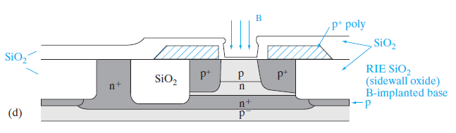
A heavily doped “extrinsic” p+ base is formed by diffusion of B from the doped polysilicon layer into the substrate in order to provide a low-resistance, high-speed base ohmic contact.
An oxide layer is then deposited by LPCVD, which has the effect of closing up the base window that was etched previously, and B is implanted into this window.
This base implant forms a more lightly p doped “intrinsic” base through which most of the current flows from the emitter to the collector.
Fig (d): intrinsic base implant using self-aligned oxide sidewall spacers;

Slide 18
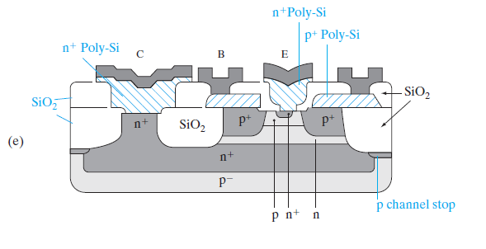
The more heavily doped extrinsic base forms a collar around the intrinsic base, and serves to reduce the base series resistance.
It is critical that the base be enclosed well within the collector because otherwise it would be shorted to the psubstrate.
Finally, another LPCVD oxide layer is deposited to close up the base window further, and the oxide is etched all the way to the Si substrate by RIE, leaving oxide spacers on the sidewalls.
Heavily n+ doped (typically with As) polysilicon is then deposited on the substrate, patterned and etched, forming polysilicon emitter (polyemitter) and collector contacts, as shown in Fig.e.
Fig (e): self-aligned
formation of n+ emitter, as well as n+ collector contact.

Slide 19
The use of two LPCVD polysilicon layers referred to as the double-polysilicon process.
Arsenic from the polysilicon is diffused into the substrate to form the n+ emitter region nested within the base in a self-aligned manner, as well as the n+ collector contact.
Self-alignment refers to the fact that a separate lithography step is not required to form the n+ emitter region.
The oxide sidewall spacers is used to ensure that the n+ emitter region lies within the intrinsic p-type base.
This is critical because otherwise the emitter gets shorted to the collector; we also want a gap between the n+ emitter and the p+ extrinsic base, because otherwise the emitter–base junction capacitance becomes too high.
In the vertical direction, the difference between the emitter–base junction and the base–collector junction determines the base width.
This is made very narrow in high gain, high speed BJTs.

Slide 20
Finally, an oxide layer is deposited by CVD, windows are etched in it corresponding to the emitter (E), base (B), and collector (C) contacts, and a suitable contact metal such as Al is sputter deposited to form the ohmic contacts.
The Al is patterned photolithographically using the interconnect mask, and etched using RIE.
The many ICs that are made simultaneously on the wafer are then separated into individual dies by sawing, mounted on suitable packages, and the various contacts are wire bonded to the external leads of the package.

